Slide 1
Parallel - schikking
Integrale opdracht
Schaalschikking in stijl

Slide 2

Parallelschikking

Slide 3

Parallelschikking

Slide 4
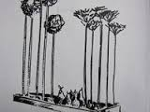

Parallelschikking

Slide 5
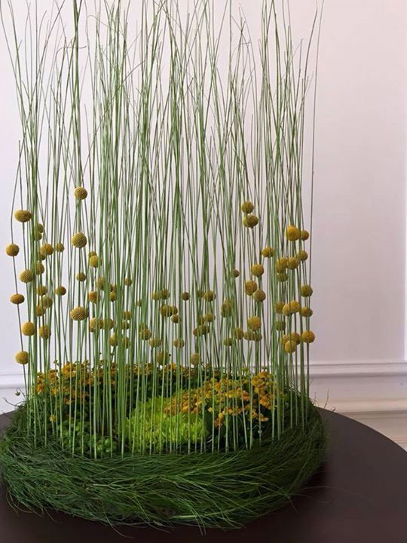
Parallelschikking

Slide 6
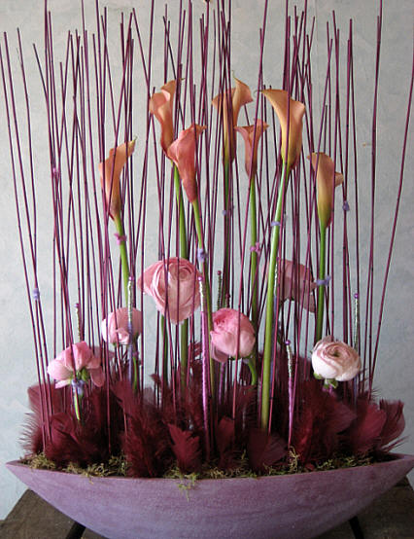
Parallelschikking

